Slide 1
Performing ETL on a Dataset by Using AWS Glue
Made for Professor Lanham A. by Amrit Singh

Slide 2
AGENDA
Accessing the AWS management console
Task 1: Using an AWS Glue crawler with the GHCN-D dataset
Task 2: Querying a table by using Athena
Task 3: Creating a CloudFormation template for an AWS Glue crawler
Task 4: Reviewing the IAM policy for Athena and AWS Glue access
Task 5: Confirming that Mary can access and use the AWS Glue crawler

Slide 3
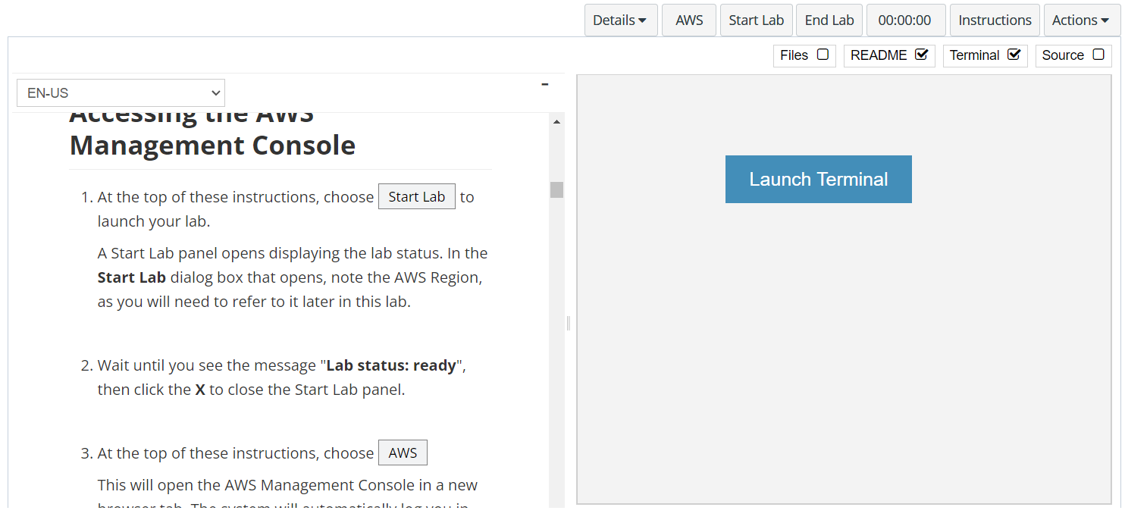
In aws labs click on start lab

Slide 4
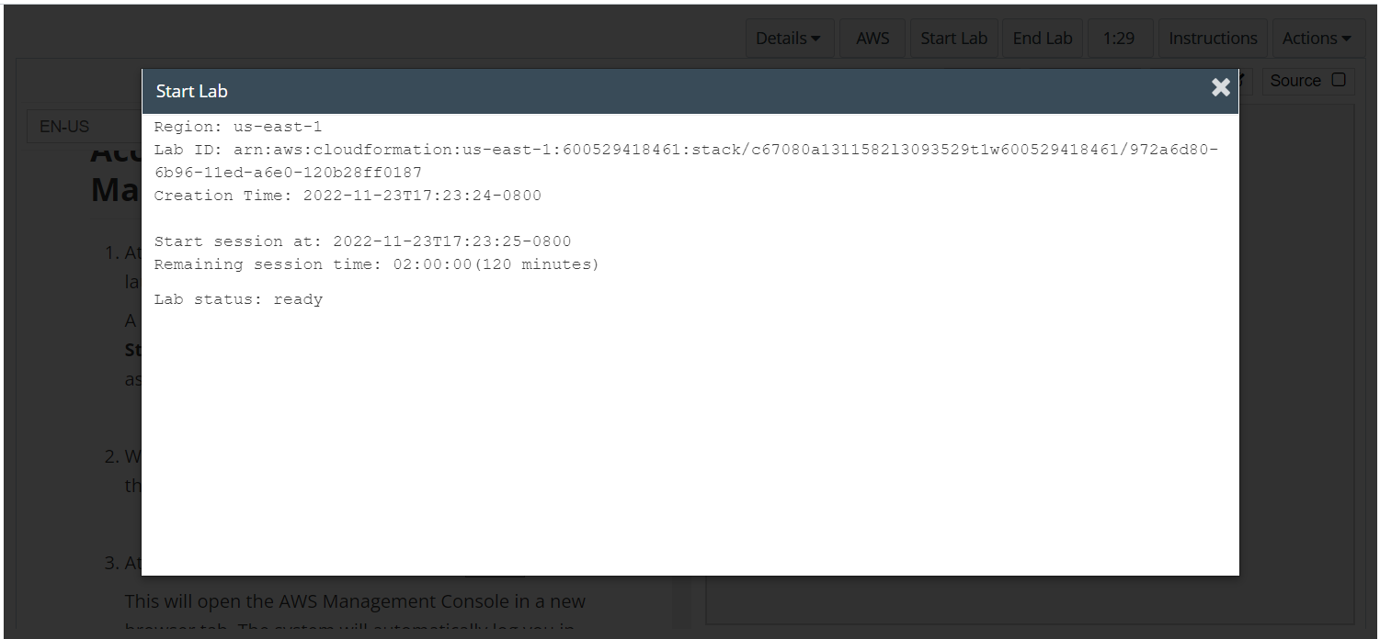
Wait to see lab ready status in the window then press x and click on aws to launch console

Slide 5
Task 1: Using an AWS Glue crawler with the GHCN-D dataset

Slide 6
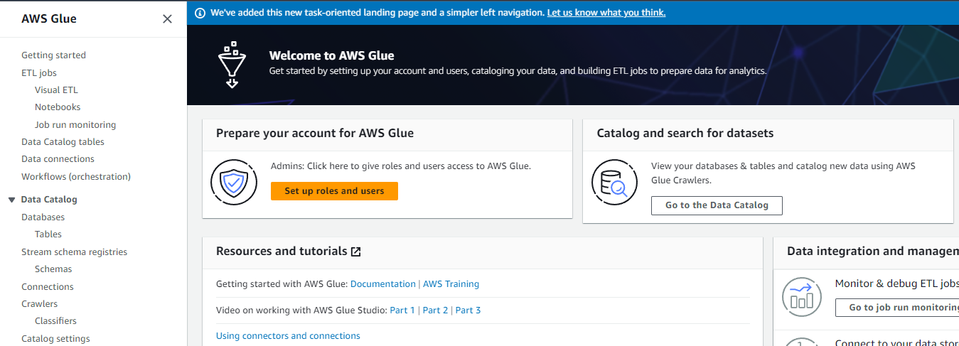
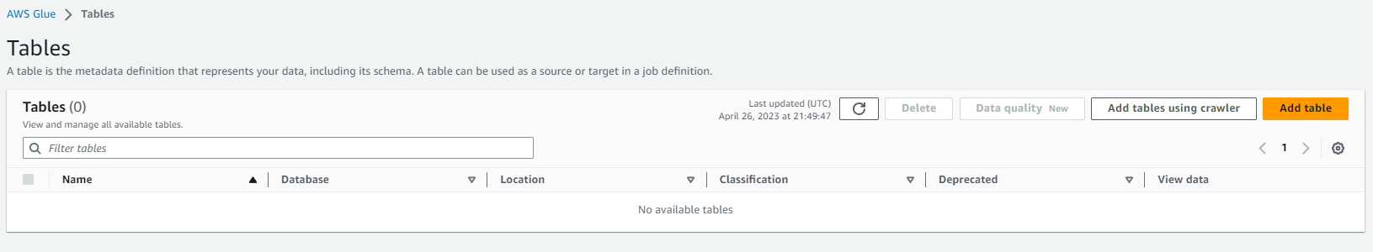
OPEN THE AWS GLUE CONSOLE
Configure and create the AWS Glue crawler.
In the AWS Management Console, in the search box next to Services, search for and choose AWS Glue to open the AWS Glue console.
In the navigation pane, under Databases, choose Tables.
Choose Add tables using crawler.

Slide 7
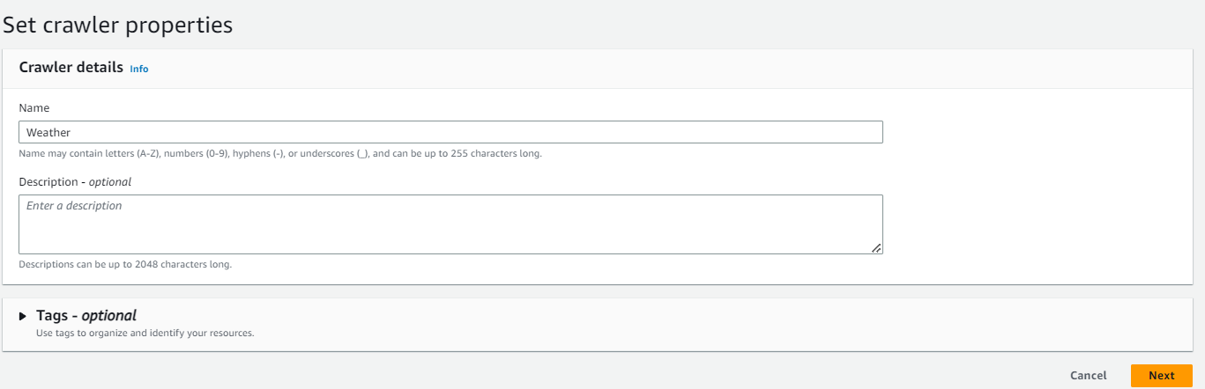
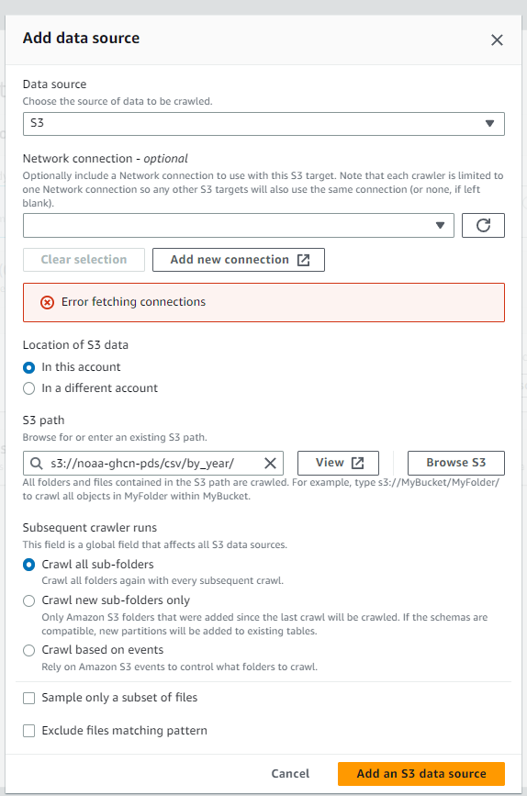
Setup the crawler
For Name, enter Weather
Expand the Tags (optional) section.
Notice that this is where you could add tags or extra security configurations. Keep the default settings.
Choose Next at the bottom of the page.
Choose Add a data source and configure the following:
Data source: Choose S3.
Location of S3 data: Choose In a different account.
S3 path: Enter the following S3 bucket location for the publicly available dataset: s3://noaa-ghcn-pds/csv/by_year/
Subsequent crawler runs: Choose Crawl all sub-folders.
Choose Add an S3 data source.

Slide 8
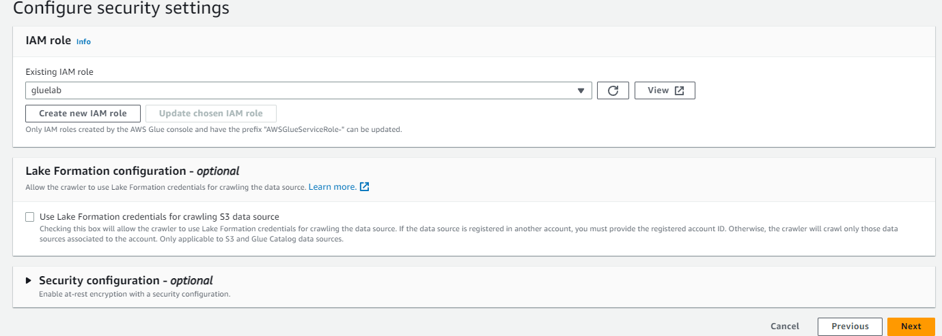
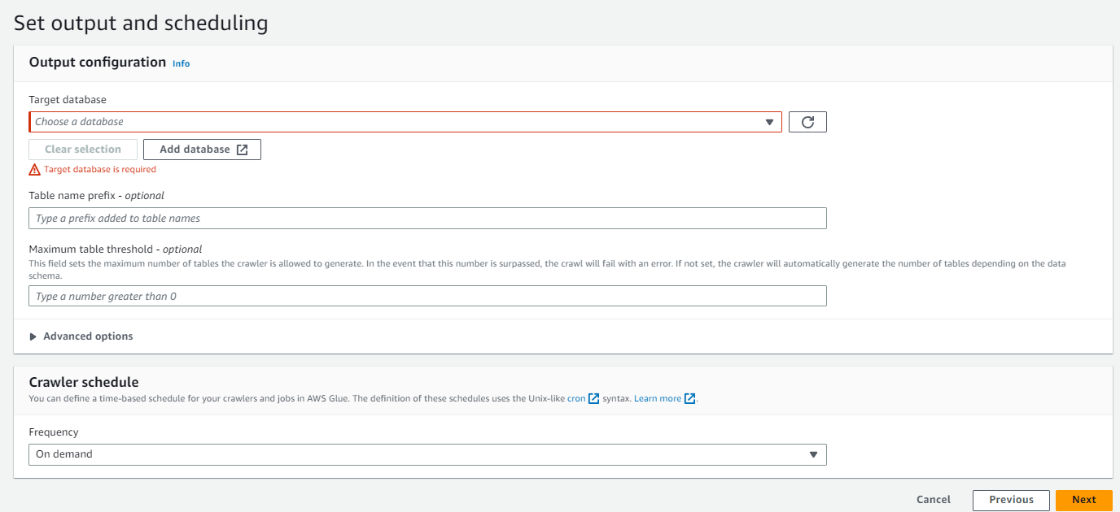
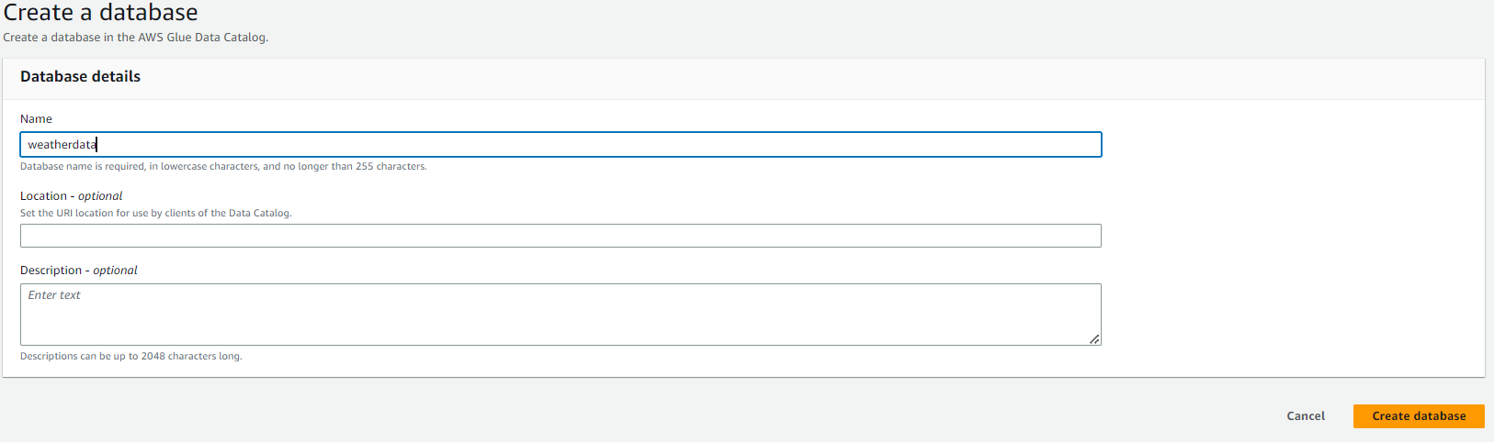
configure the IAM policy and set the target database
For Existing IAM role, choose gluelab.
This role was provided in the lab environment for you. For reference, see the lab's CloudFormation template.
Choose Next.
In the Output configuration section, choose Add database.
A new browser tab opens.
For Name, enter weatherdata

Slide 9
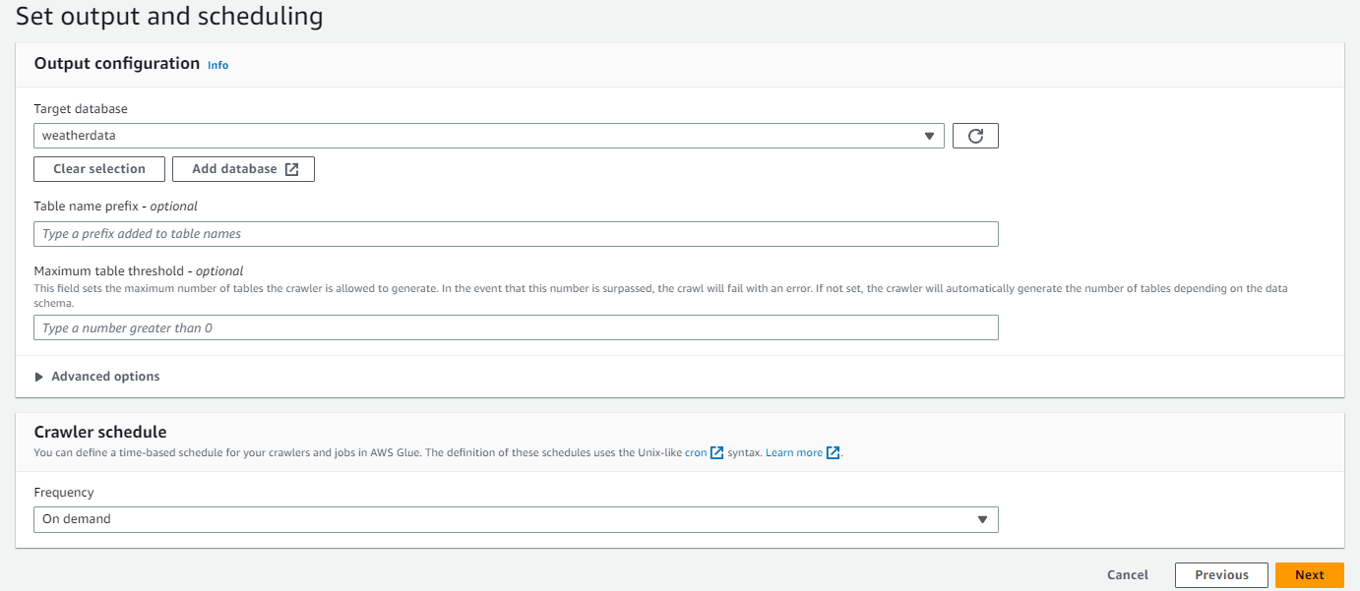
Continue the setup of output and scheduling
Return to the browser tab that is open to the Set output and scheduling page in the AWS Glue console.
For Target database, choose the weatherdata database that you just created.
In the Crawler schedule section, for Frequency, keep the default On demand.
Choose Next.
Confirm your crawler configuration is similar to the following.
Choose Create crawler.

Slide 10
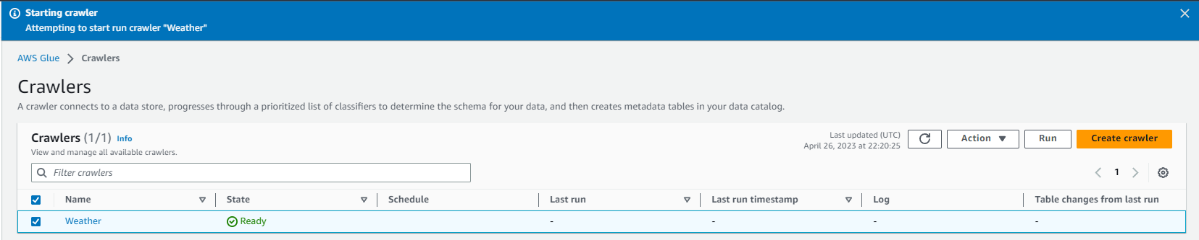
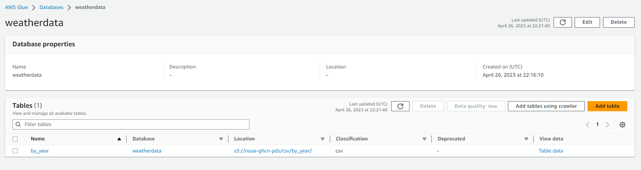
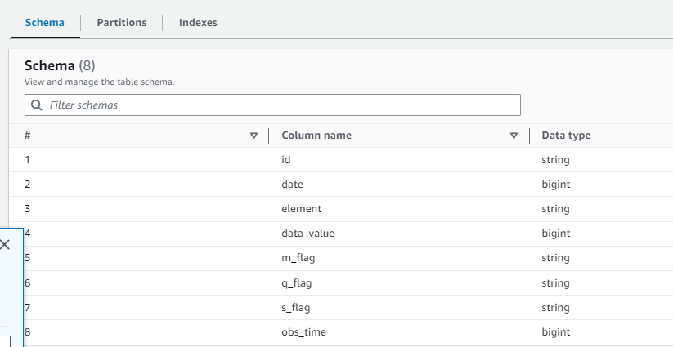
Run the crawler and review the metadata
Run the crawler.
On the Crawlers page, select the Weather crawler that you just created.
Choose Run.
The crawler state changes to Running.
Review the metadata that AWS Glue created.
In the navigation pane, choose Databases.
Choose the link for the weatherdata database.
In the Tables section, choose the by_year link.

Slide 11
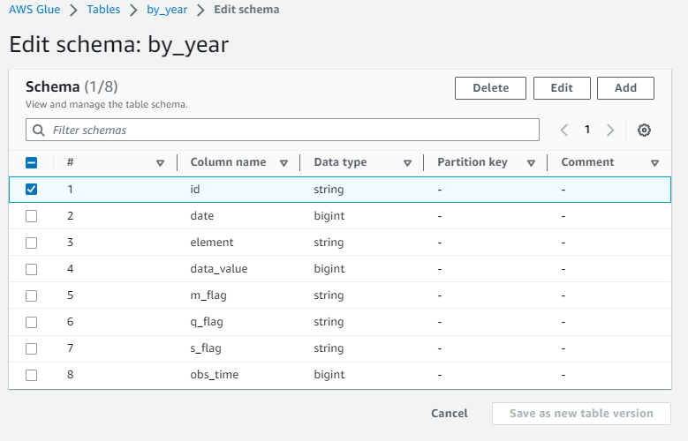
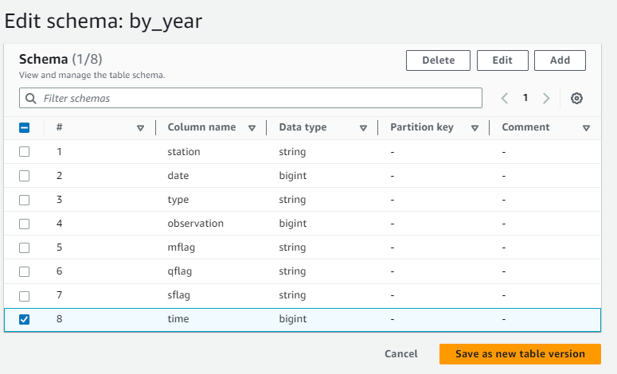
Configure the tables and views in the database continued
Edit the schema.
From the Actions menu in the upper-right corner of the page, choose Edit schema.
Change the column names according to the following table.
To change a column name, select the check box for the item that you want to modify, and then choose Edit.
In the window that opens, change the value for the Name, and then choose Edit. Repeat these steps for each column name
Choose Update schema.

Slide 12
Task 2: Querying a table by using Athena

Slide 13
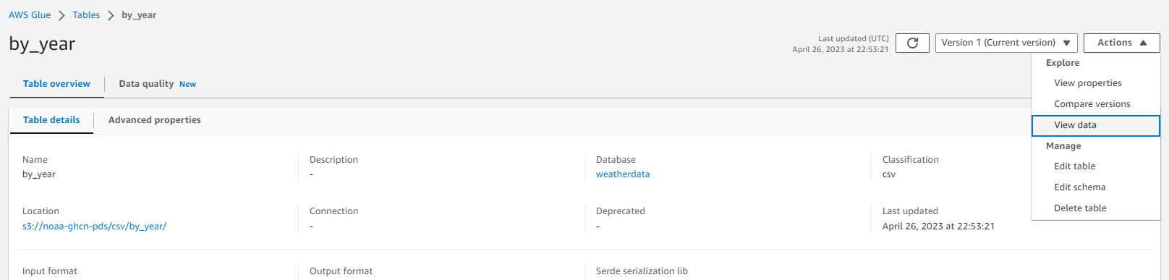
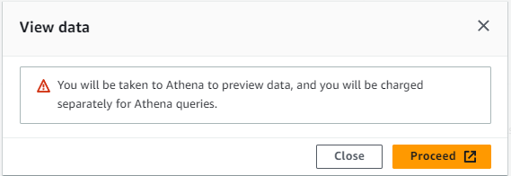
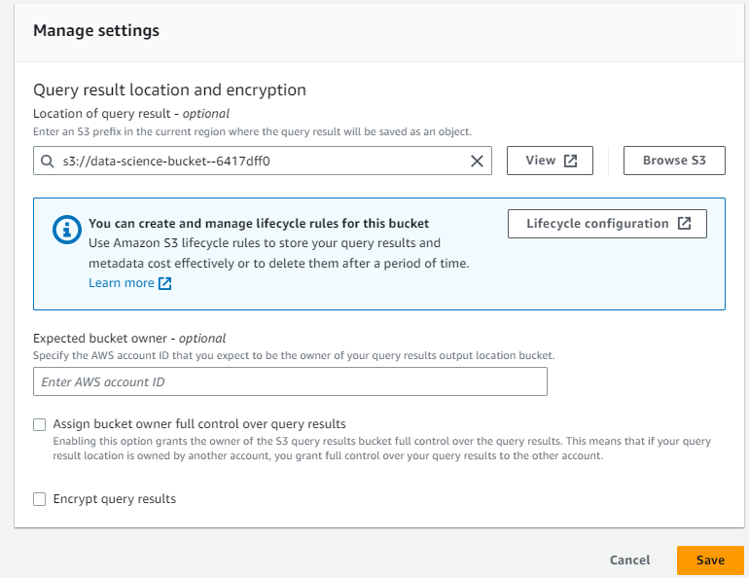
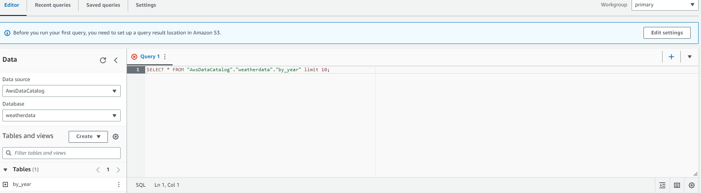
Setting up athena
Configure an S3 bucket to store Athena query results
In the navigation pane, under Databases, choose Tables.
Choose the link for the by_year table.
Choose Actions > View data.
When the pop-up appears to warn you that you will be taken to the Athena console, choose Proceed.
The Athena console opens. Notice the error message that indicates that an output location was not provided. Before you run a query in Athena, you need to specify an S3 bucket to hold query results.
Choose the Settings tab.
Choose Manage.
To the right of Location of query result, choose Browse S3.
Choose the bucket name that is similar to the following: data-science-bucket-XXXXXX
Select Choose.
Keep the default settings for the other options, and choose Save.

Slide 14
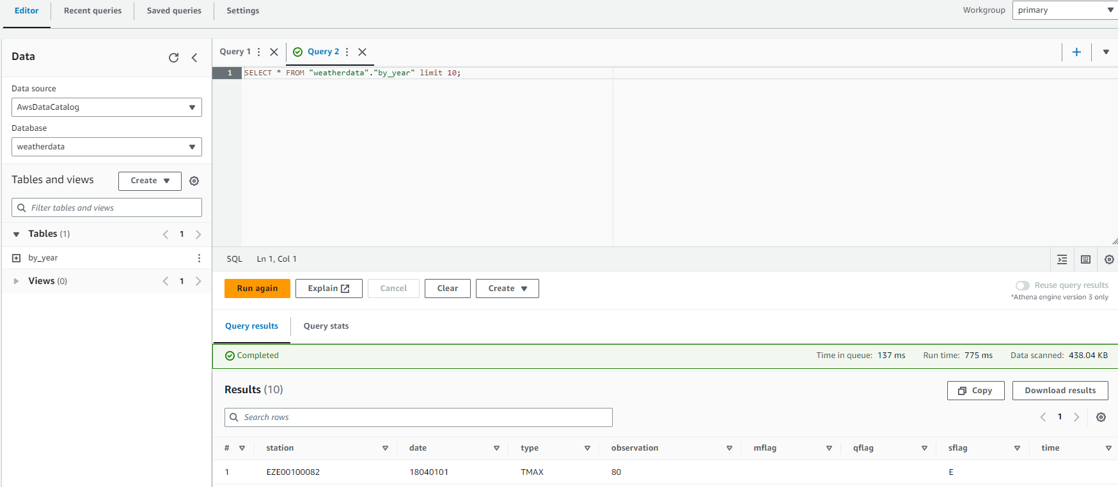
Previewing a table in athena
Preview a table in Athena.
Choose the Editor tab.
In the Data panel on the left, notice that the Data source is AwsDataCatalog.
For Database, choose weatherdata.
In the Tables section, choose the ellipsis (three dot) icon for the by_year table, and then choose Preview Table.

Slide 15
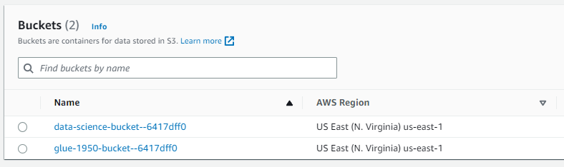
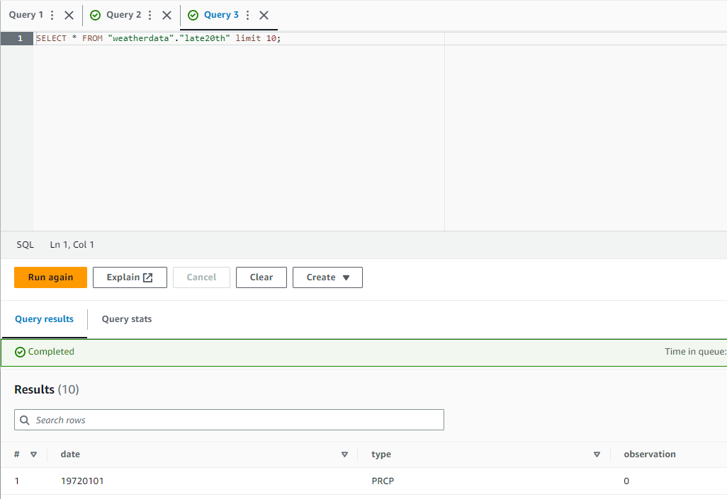
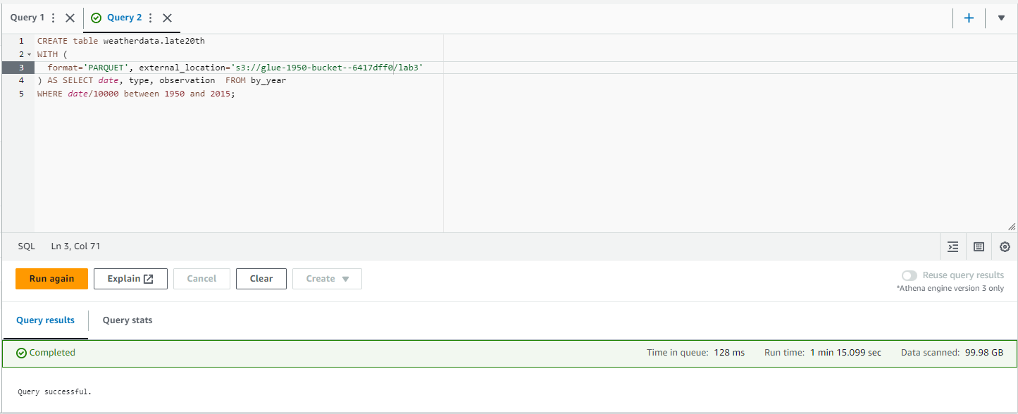
Creating a new table
Create a table for data after 1950.
First, you need to retrieve the name of the bucket that was created for you to store this data.
In the search box next to Services, search for and choose S3.
In the Buckets list, copy the bucket name that contains glue-1950-bucket to a text editor of your choice.
Return to the Athena query editor.
Copy and paste the following query into a query tab in the editor. Replace <glue-1950-bucket> with the name of the bucket that you recorded:
CREATE table weatherdata.late20th
WITH ( format='PARQUET', external_location='s3://<glue-1950-bucket>/lab3') AS SELECT date, type, observation FROM by_yearWHERE date/10000 between 1950 and 2015;

Slide 16
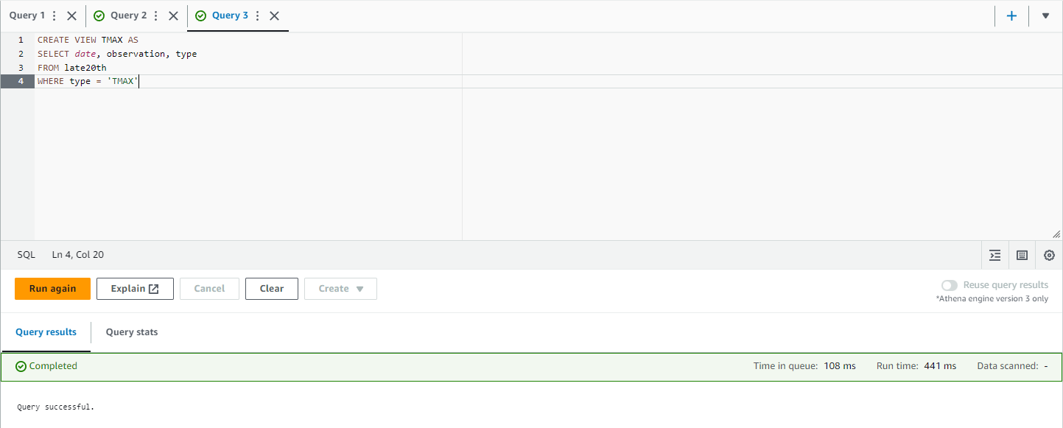
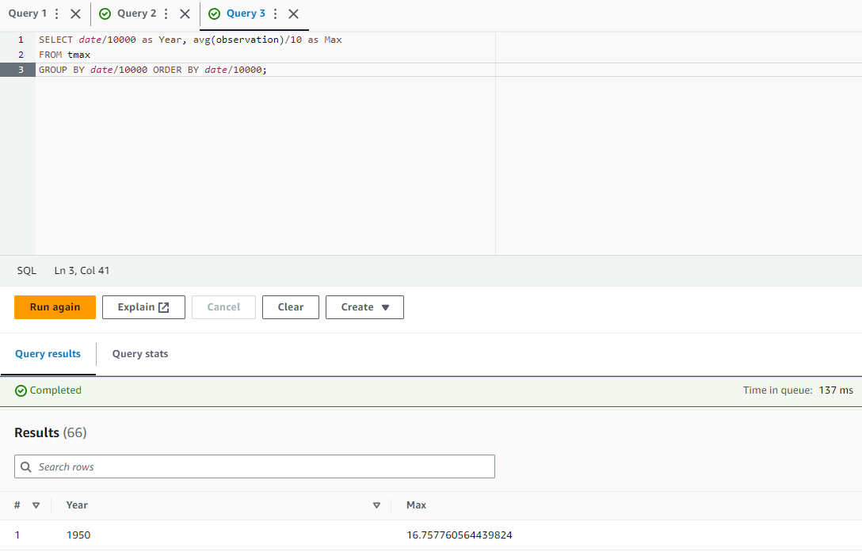
Querying on the new table
Run a query on the new table.
First, create a view that only includes the maximum temperature reading, or TMAX, value.
Run the following query in a new query tab:
To preview the results, in the Views section, to the right of the tmax view, choose the ellipsis icon, and then choose Preview View.
Run the following query in a new query tab.
CREATE VIEW TMAX AS
SELECT date, observation, typeFROM late20thWHERE type = 'TMAX'
SELECT date/10000 as Year, avg(observation)/10 as Max
FROM tmaxGROUP BY date/10000 ORDER BY date/10000;

Slide 17
Task 3: Creating a CloudFormation template for an AWS Glue crawler

Slide 18
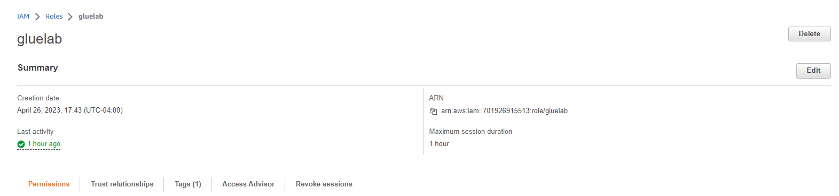
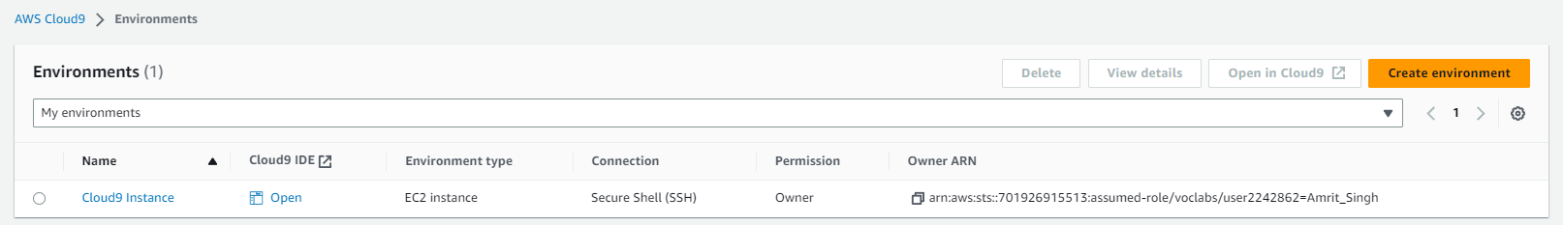
Find the arn and configure cloud9
Find the Amazon Resource Number (ARN) for the gluelab IAM role. You need this ARN to deploy the CloudFormation template.
In the search box next to Services, search for and choose IAM to open the IAM console.
In the navigation pane, choose Roles.
Choose the link for the gluelab role.
Copy the ARN to a text editor to use in the next step.
Navigate to the AWS Cloud9 integrated development environment (IDE).
In the search box next to Services, search for and choose Cloud9 to open the AWS Cloud9 console.
AWS Cloud9 environments are listed.
For the environment named Cloud9 Instance, choose Open IDE.
A new browser tab opens and displays the AWS Cloud9 IDE

Slide 19
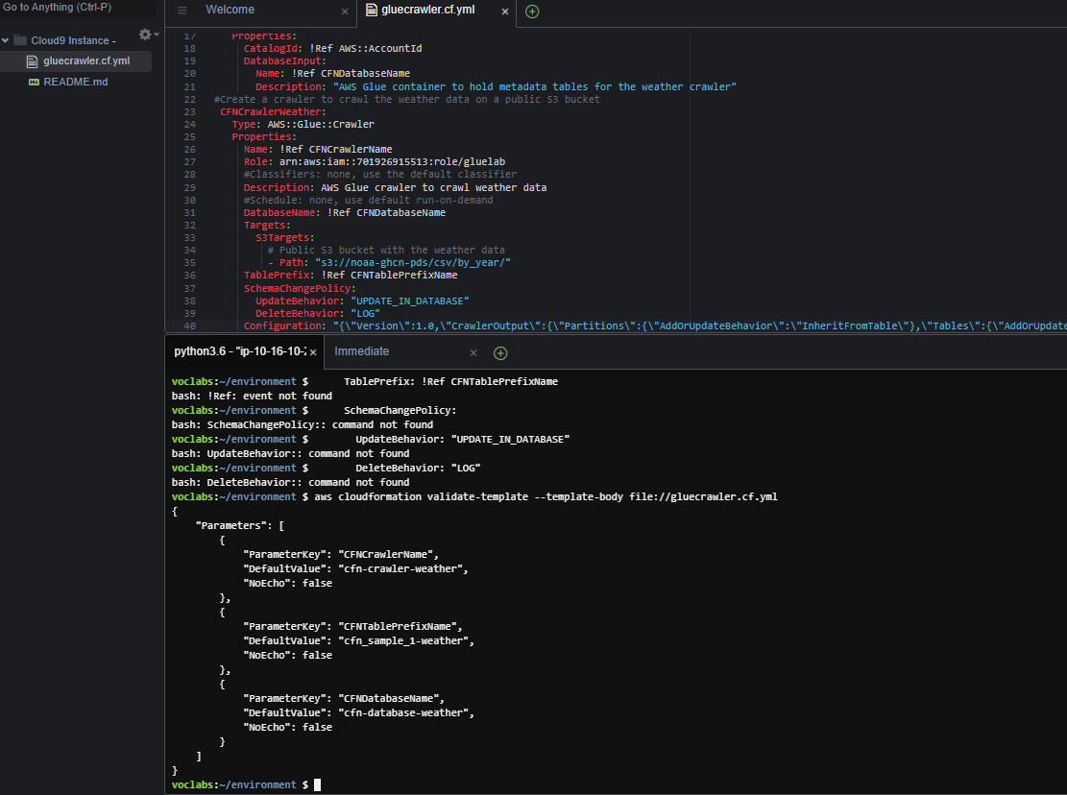
In cloud9 configure the new template
Create a new CloudFormation template.
In the AWS Cloud9 IDE, choose File > New File.
Save the empty file as gluecrawler.cf.yml but keep it open.
Copy and paste the code into the file from AWS LABS
Save the changes to the template file.
To validate the CloudFormation template, run the following command in the AWS Cloud9 terminal:
To create the CloudFormation stack, run the following command:
aws cloudformation validate-template --template-body file://gluecrawler.cf.yml
aws cloudformation create-stack --stack-name gluecrawler --template-body file://gluecrawler.cf.yml --capabilities CAPABILITY_NAMED_IAM

Slide 20
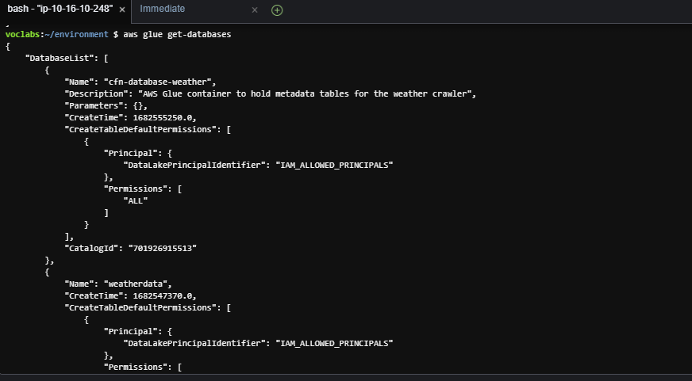
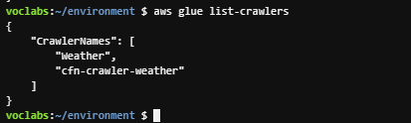
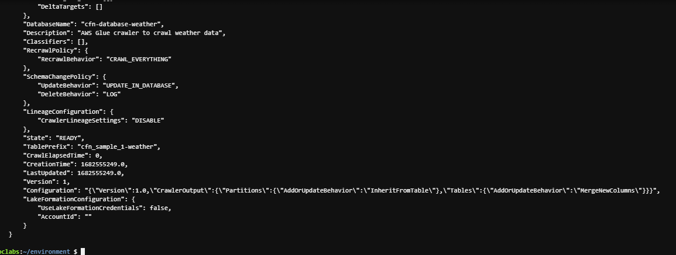
Verify that glue database was created
To verify that the AWS Glue database was created in the stack, run the following command:
Verify that the crawler was created in the stack.
To verify that the crawler was created, run the following command:
To retrieve the details of the crawler, run the following command.
aws glue get-databases
aws glue list-crawlers
aws glue get-crawler --name cfn-crawler-weather

Slide 21
Task 4: Reviewing the IAM policy for Athena and AWS Glue access

Slide 22
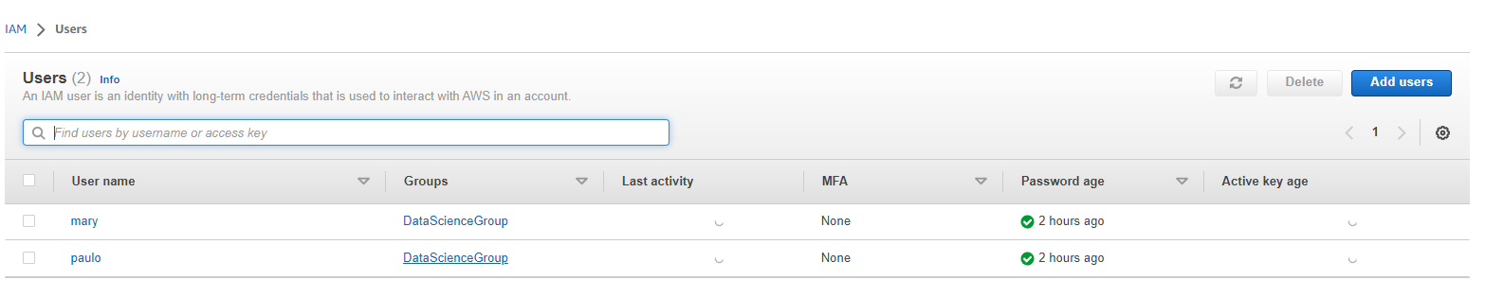
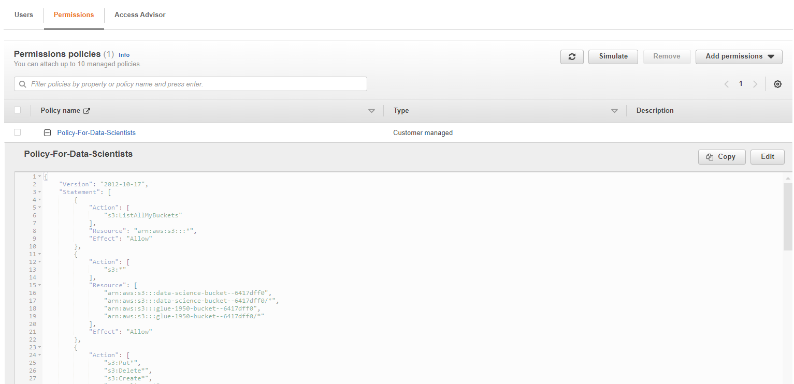
In the iam user console open the users pane to understand access
Review the Policy-For-Data-Scientists policy in IAM.
In the search box to the right of Services, search for and choose IAM to open the IAM console.
In the navigation pane, choose Users.
Note that mary is one of the IAM users that is listed. This user is part of the DataScienceGroup IAM group.
Choose the link for the DataScienceGroup IAM group.
On the DataScienceGroup details page, choose the Permissions tab.
In the list of policies that are attached to the group, choose the link for the Policy-For-Data-Scientists policy.

Slide 23
Task 5: Confirming that Mary can access and use the AWS Glue crawler

Slide 24
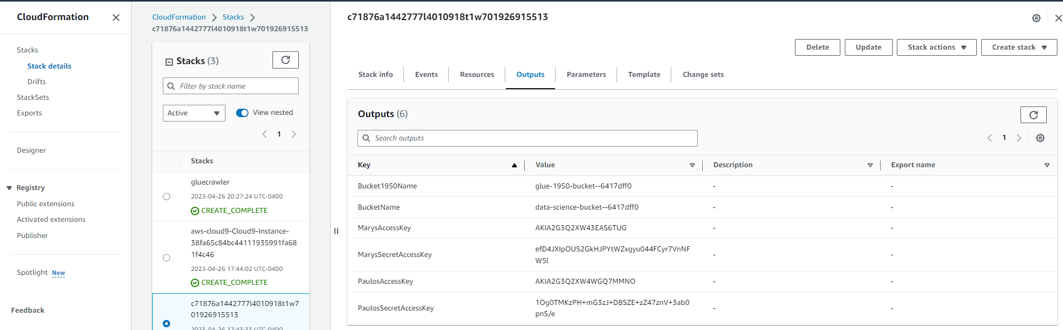
Save the acesskey and secretaccesskey from cloudformation
Retrieve the credentials for the mary IAM user, and store these as bash variables.
In the search box next to Services, search for and choose CloudFormation.
In the navigation pane, choose Stacks.
Choose the link for the stack that created the lab environment. The stack name includes a random string of letters and numbers, and the stack should have the oldest creation time.
On the stack details page, choose the Outputs tab.
Copy the value of MarysAccessKey to your clipboard.
Return to the AWS Cloud9 terminal.
To create a variable for the access key, run the following command. Replace <ACCESS-KEY> with the value from your clipboard.
AK=<ACCESS-KEY>
Return to the CloudFormation console, and copy the value of MarysSecretAccessKey to your clipboard.
Return to the AWS Cloud9 terminal.
To create a variable for the secret access key, run the following command. Replace <SECRET-ACCESS-KEY> with the value from your clipboard.
SAK=<SECRET-ACCESS-KEY>

Slide 25
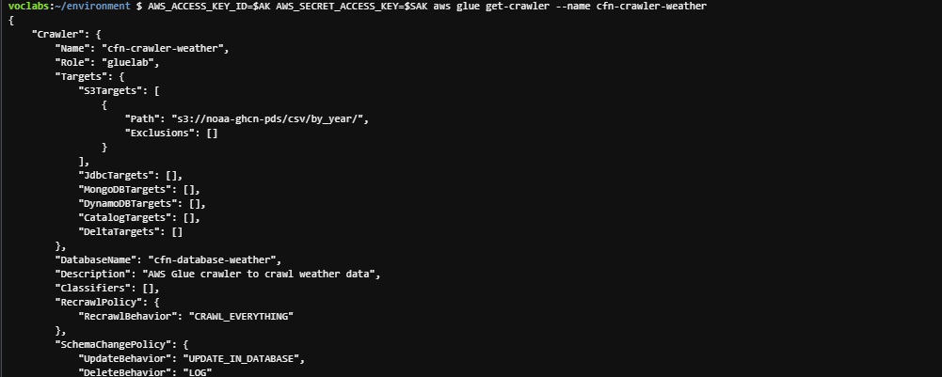
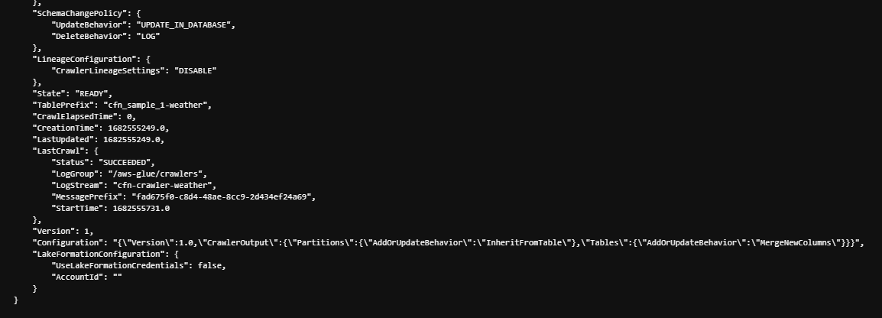
Setup ide with mary’s access keys and test the access
Test Mary's access to the AWS Glue crawler.
To test whether the mary user can perform the list-crawlers command, run the following command:
AWS_ACCESS_KEY_ID=$AK AWS_SECRET_ACCESS_KEY=$SAK aws glue list-crawlers
To test whether the mary user can perform the get-crawler command, run the following command:
AWS_ACCESS_KEY_ID=$AK AWS_SECRET_ACCESS_KEY=$SAK aws glue get-crawler --name cfn-crawler-weather
Test that the mary user can run the crawler.
Run the following command.
AWS_ACCESS_KEY_ID=$AK AWS_SECRET_ACCESS_KEY=$SAK aws glue start-crawler --name cfn-crawler-weather
To observe the crawler running and adding data to the table, navigate to the AWS Glue console.
In the navigation pane, choose Crawlers.
To confirm that the crawler is finished running, run the following command.
AWS_ACCESS_KEY_ID=$AK AWS_SECRET_ACCESS_KEY=$SAK aws glue get-crawler --name cfn-crawler-weather

Slide 26
THANK YOU
Amrit Singh

